Slide 1

Empowering Power BI Reports with Power Apps and Power Automate
Making Your Data Actionable!
Notes:
In this presentation, we will explore the benefits of embedding PowerApps into PowerBI reports and how to do it. Join us on this journey to enhance your Power BI reports with PowerApps.

Slide 2








Please thank our sponsors

Slide 3

Introduction and Background
Eric Duncan
Senior Solutions Architect
18 years at JE Dunn Construction in Systems Admin, Datacenter Admin, Infrastructure Management, DevOps, and Power Platform
I’m a creator, a maker, an integrator, a solutioner, a problem solver
Canvas App enthusiast, Power Automate devotee, and starting to love Model-Driven Apps and Dataverse
I love blending technologies in new and innovative ways
Notes:
In this slide, we will introduce the presenter and provide some background information. The presenter has 18 years of experience at JE Dunn Construction in multiple areas. The presenter is a problem solver, creator, and integrator. The purpose of this presentation is to empower PowerBI Reports with PowerApps and Flows to enable users to interact with data in real time and make informed decisions. The images in this slide consist of an office desk and construction tools to represent the presenter's background.

Slide 4



Slide 5


ENR Top 20
~ $7bn in revenue for 2024
Privately held, employee owned
Headquartered in Kansas City with 26 offices nationwide
5,000+ employees, ~100 in Information Technology
Celebrating 100 years in 2024
Just acquired Premium licenses for Power Apps and Power Automate for every user

Slide 6

Caveats and Disclaimers
I’m not a DBA
I’m not a data scientist
I’m not a Power BI expert
I also really suck at staying organized
All brands and product names mentioned are trademarks or registered trademarks of their respective companies. Patent pending. All sales final.
Void where prohibited by law. No purchase necessary. Low in saturated fat. May contain peanut products. Do not read this document if the
printed seal is broken or missing. Do not drive a vehicle or operate heavy machinery while reading this document. Call a physician if swelling persists

Slide 7

Purpose of this Talk
  What’s the most common keystroke in Power BI?
Alt - Tab

Slide 8
Purpose of this Talk
  How many times do you or your coworkers look at a report, and then go to Outlook/Teams/Slack/PowerApps/SharePoint/ERP/{insert name of app here} to actually take action on that data:
    “Hey, what about these numbers?”
    “I need to send an email to this manager about this”
    “It’s OK to proceed on this”
    “Send a reorder notice after a review”
Why not initiate the action right within the report?

Slide 9
Why do we separate Report Building and Applications?
Report Development Team
Reporting
Data Aggregation Layer
App Development Team
Application
Data

Slide 10
Alternative Design Pattern
Application
Reporting
What if PowerBI was
considered an application-
delivery platform in addition to a reporting platform?
Data Aggregation Layer
Data

Slide 11
First Light Moment
IT Asset Upgrade
We are assigned IT assets (laptops, cell phones).
Those assets have a defined lifespan (typically 3 years)
After the end of that lifespan, they’re eligible to be upgraded
End-users request those upgrades
Assets are managed in Flexera in a proprietary database
  Rich API for data exports
Employees have machine options based upon their role

Slide 12
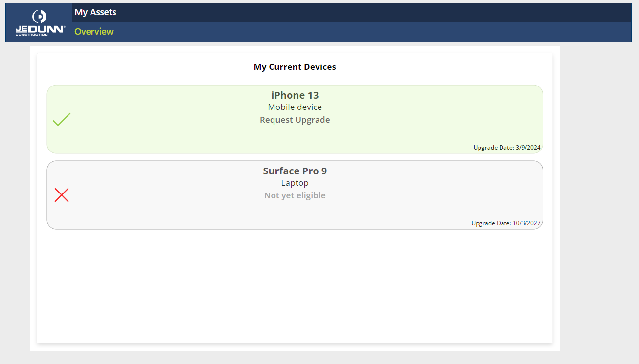
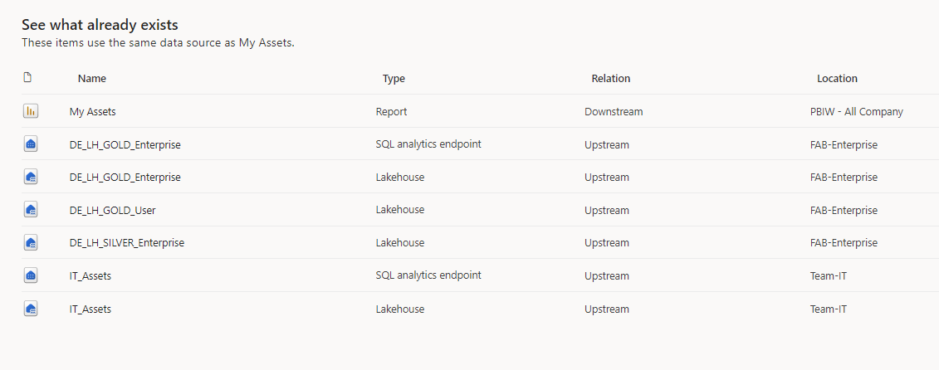
First Light Moment
IT Asset Upgrade
The Reporting Team put together a report in Power BI to display a person’s devices and when they were eligible for upgrade
They requested a PowerApp to be created that could be linked to the report to request an upgrade.
That PowerApp creates a request in Jira to start the upgrade process
First version: Power BI report with cards showing data. Simple Power App that had a single button to request upgrade
Second version: Power BI report with no visuals but a Power App with a card-styled gallery that acted as buttons
The Report became the app. Or did the app become the report?

Slide 13
First Light Moment
IT Asset Upgrade
Demo

Slide 14
First Light Moment
IT Asset Upgrade
What is Power BI bringing to the table?
  Complex data relationships of enterprise data
  Row-level security
  Reusable datasets
  Content delivery platform in “Apps”
What is Power Apps bringing?
  Rapid development approach
  Intuitive user interactions
  The app was created over a 2-day period by a summer intern

Slide 15

What if we could ACT on our data right within the report?

Slide 16

Case Study (Real World Example)
Over 6000 SharePoint 2013 sites to migrate to SharePoint Online
Some were in active use, some were winding down but still considered “open”, while others were long retired
We engaged with a consulting firm to automate the majority of the “heavy lifting” of the migrations using PowerShell Scripts and ShareGate
But the consultant was in the UK, the project teams were all over the US, and I was in Portland, OR
It was an organizational nightmare challenge
Oh, and we had 5 months to complete the engagement

Slide 17

Case Study (Real World Example)
Each SharePoint site had an entry in our project management database for project status and key players
We needed to organize our migrations into batches that could be accomplished overnight
We needed to send multiple communications to our project teams to prepare them for the migration
The consultants used the SharePoint List was a “work to do” queue.
We used the SharePoint List as our own work-to-do for the pre-work prior to the migrations

Slide 18
Case Study (Real World Example)
  The SharePoint list started life as a simple export of all site collections from SP2013
  We programmatically added a unique ID in the SharePoint list that joined the data from ERP
  We scripted the exports of IIS logs to CSV using LogParser

Slide 19

Step 1 – Get your data together
Enter Power BI!
  Merge SharePoint tracking list (the Inventory)
  With ERP data (the Project status)
  With IIS logs (the activity levels)
  Let the authoritative source remain authoritative!
We now had a unified picture of “Current State” but still had to take manual efforts to communicate actions
  Emails, Teams messages, SharePoint list status updates
  Emails to the project teams (from two standard templates)
  “Is this site ready to migrate?” “What sites are migrating tonight, tomorrow, this weekend?”

Slide 20

Step 2 - Enter Power Automate buttons!
Added buttons to the report to:
  Send notification and reminder emails to the project teams for active sites
  Create SPO sites using our standard build process in Azure Automation
  Update the migration tracker “Ready to Migrate” status

Slide 21

Demo

Slide 22


Best Practices
Get your data together and ensure your relationships are accurate
Add the Power Automate buttons or PowerApp visuals in the web designer not the Power BI Desktop editor
Bind the data elements to the button that your Flow or App will rely on
  Eliminates the need for subsequent data calls or data sources
Utilize the PowerBIIntegration element in PowerApps for bound data

Slide 23
Best Practices
In Power Automate Flows, make sure you check how many records are passed into the Flow. (Not selecting records sends ALL records)
Utilize the PowerBIData data element in the Flow as an array passed in as a parameter to the trigger

Slide 24





Questions

Slide 25

Submit session feedback

